Slide 1

Bargaining Town Hall

Slide 2
Logistics
Please rename yourself in Zoom
Remain on mute throughout the town hall for the best audio quality
A recording of the town hall will be posted to the website
Save your questions until the Q&A section

Slide 3
Agenda
Introductions
Overview of proposals
Update on bargaining
Next steps
Q+A

Slide 4
Your CIPP negotiating committee
Wendy Schurman (Negotiating Committee Chair)
Bev Croft (CIPP President)
Andrew Gleeson (CIPP Vice President)
Ahmad Luqman (CIPP Board Member)

Slide 5
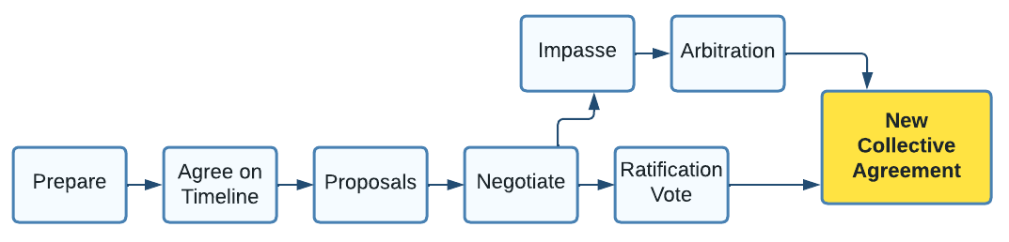
The bargaining process
2017-2019
2020-2022
2023-2025
2026-…
202?-…
203?-…
Consultation
You are here!
Research

Slide 6
A new approach
Disappointment and frustration
  Poor results from arbitration
Getting on a better path
  Employer at fault but our union’s – and our – responsibility
Facts and arguments are not enough
  A new approach to bargaining
Action and engagement beyond the table
  Connect and building our union’s power

Slide 7
A new approach
2017-2019
2020-2022
2023-2025
2026-…
202?-…
203?-…
Consultation
Research
Member Engagement & Action
Supermajority support for petition
Connect network launched
March 10 Day of Action

Slide 8
Fair pay
“Do more and get less”
  5 years of losing ground on pay
Two-year term
  7.5% (2026) and 6% (2027)
Repair past damage from previous awards
  5% cost of living adjustment

Slide 9
Benefits
Higher caps and more flexibility on extended health benefits
  Massage, physio, mental health
Increase coverage for dental and vision
New Health Care Spending Account (HCSA)
Retiree benefits move toward best practices
No medical notes for massage

Slide 10
Other proposals
Performance pay/management
  Capped at $600,000 in 2009
  Replace a broken system
Better work/life balance
  Improve leave provisions
Defending your right to hybrid work
Job security
  Contracting out and generative AI

Slide 11
Our bargaining expectations
Get to the table before expiry
Send representatives empowered to bargain
Resolve simple issues at the table
Address and respond to our priorities
Offer fair pay

Slide 12
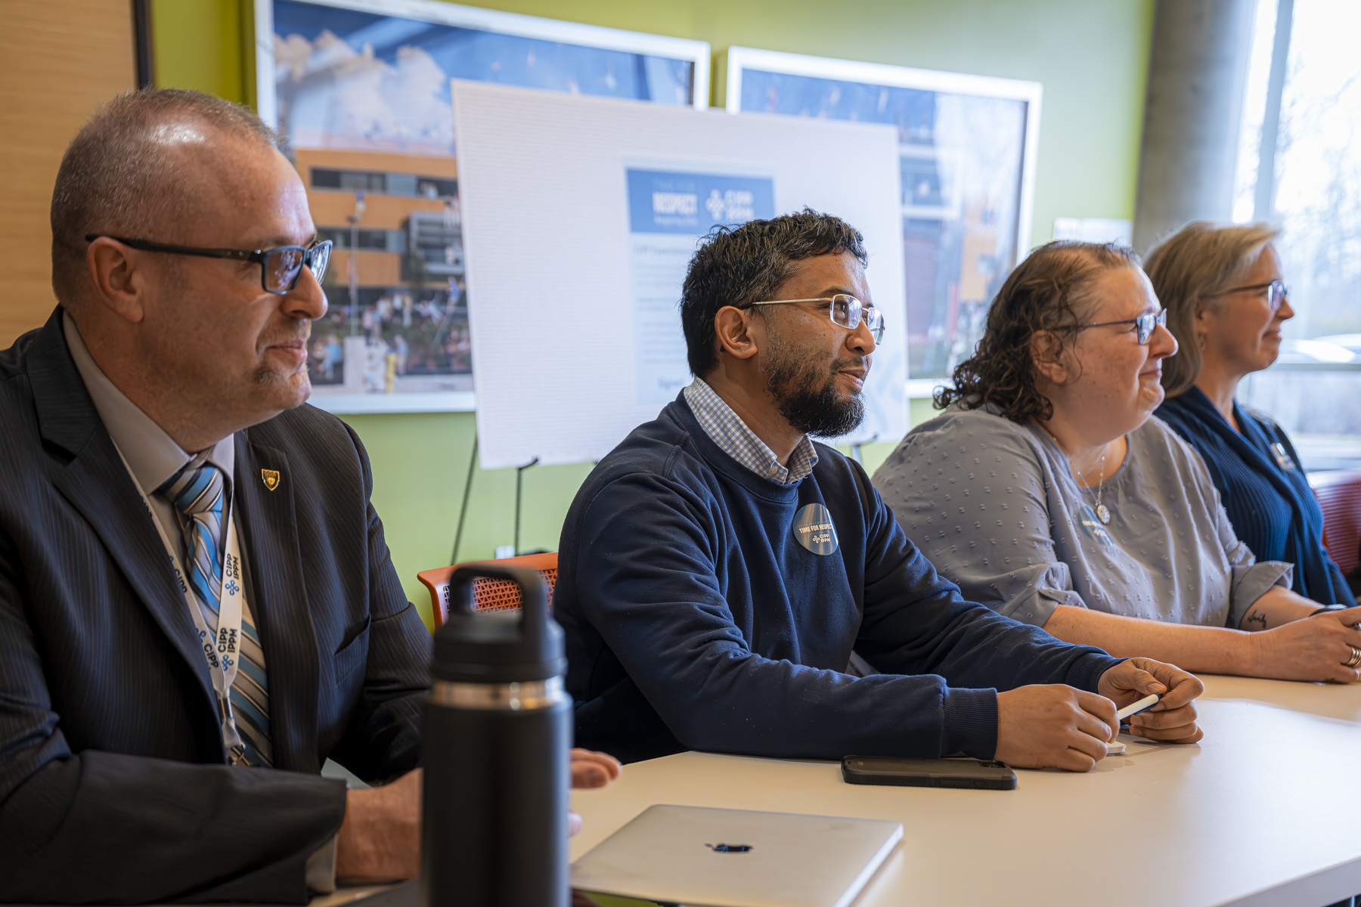
November 19, 2025
Bargaining Day 1
  City Manager Wendy Stephanson and City’s Chief Human Resources Officer in attendance
Peter's opening statement

Slide 13
Update
Petition momentum drives an early start
  Exchanged proposals in November (vs. March last round)
  CUPE has been at the table since last March 2025
With decision-makers at the table
  City Manager and HR Chief at the table
Discussions at the table
Progress on some priority items
  Health services – massage, physiotherapy, mental health, vision, dental.
  Kilometric rate increase for vehicle expenses

Slide 14
Our toughest challenges are ahead!
Your employer hasn't responded yet on:
  Hybrid work
  Job security
  Pay
There has been progress, but there is still a lot of work ahead of us
We need to remind the employer that it is time for respect!

Slide 15
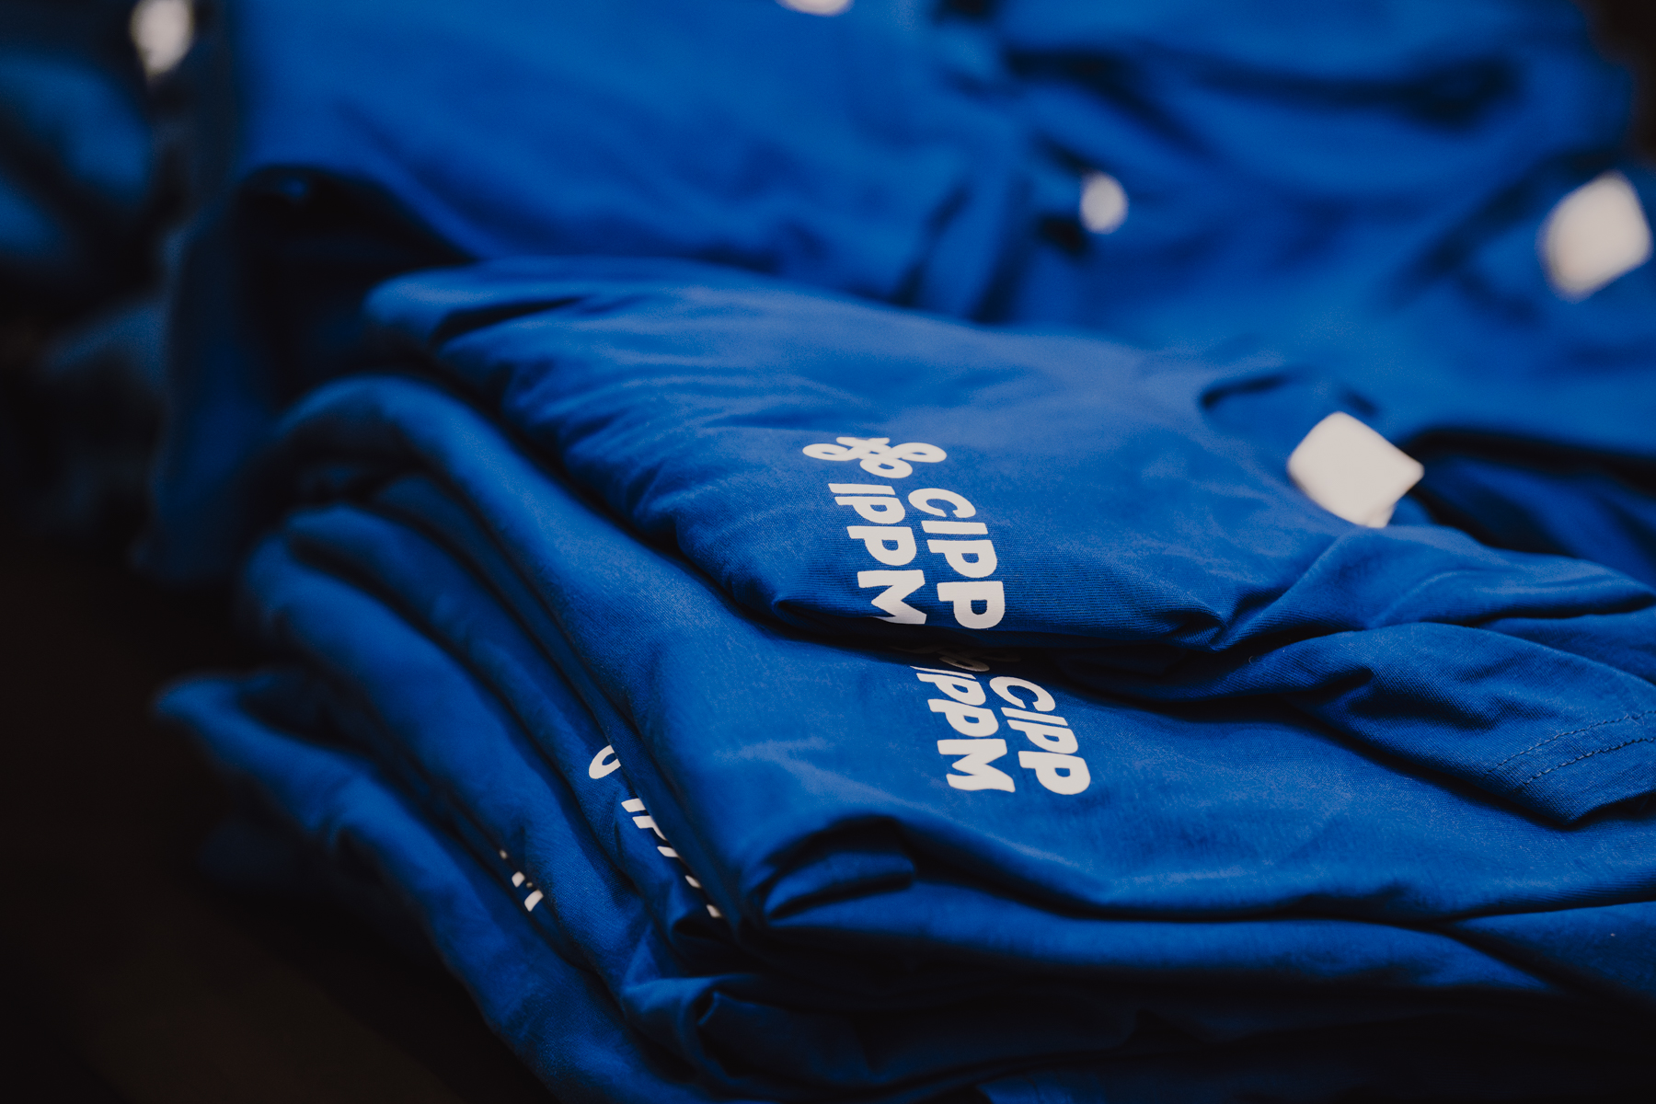
March 10 Day of Action
It’s time for a visible show of support
Wear blue or CIPP swag across the City of Ottawa
  T-shirts, stickers, buttons, pins and lanyards
  Teams backgrounds and email signatures
In the office or working from home
  No action is too small
  Solo or with colleagues
Contest
  Take a photo and send it to connect@cipp.on.ca and win a $500 gift card.

Slide 16
It’s up to us!
Negotiating committee will continue to push for the best deal possible
  Our progress really depends on YOU!
Employer has a history of not negotiating constructively
  We still haven’t had a response on fair pay
CIPP’s power comes from you
  Taking action on March 10 demonstrates our unity and strength

Slide 17
Questions?
New approach?
Who is at the table?
Progress on priority issues?
  Pay
  Health benefits
  Retirement benefits
  Leave
  Hybrid work
  Job security
How long will it take?

Slide 18
Q&A
Raise your hand in the chat to ask a question
We will call on you and ask you to unmute yourself
Please introduce yourself with your full name
  Once you have asked your question we ask that you mute yourself again for the best audio quality on the recording.
Lower your hand once you have asked your question
If you do not want to ask a question publicly please email us at connect@cipp.on.ca with your question

Slide 19
Thank you
This is just the first bargaining town hall
  Watch your inbox for an invitation to the next town hall in the coming months (Get blue and get visible on March 10)
Day of Action is March 10
  Wear blue, use a CIPP Teams background, make your support visible
Negotiating team's work continues but every member plays a role in the success of bargaining
Visit our website and watch for emails from us for bargaining updates

